Slide 1
Big Data & Cloud Computing
Name - Sagar Jadhav
Student ID - 19276146
Subsystem - Cloud Operator

Slide 2
Modifications in the Architecture Design
1. Initially, there were separate student and staff survey managers in the design.
2. These separate managers resulted in a higher number of APIs and increased system load.
3. Eventually, these managers were merged into a single entity, reducing the number of APIs and alleviating system load.
4. The merging of these managers also involved consolidating them into a single database for streamlined data management.
5. However, it's worth noting that the merged manager can still be separated into student and staff filtration in the future if needed.

Slide 3
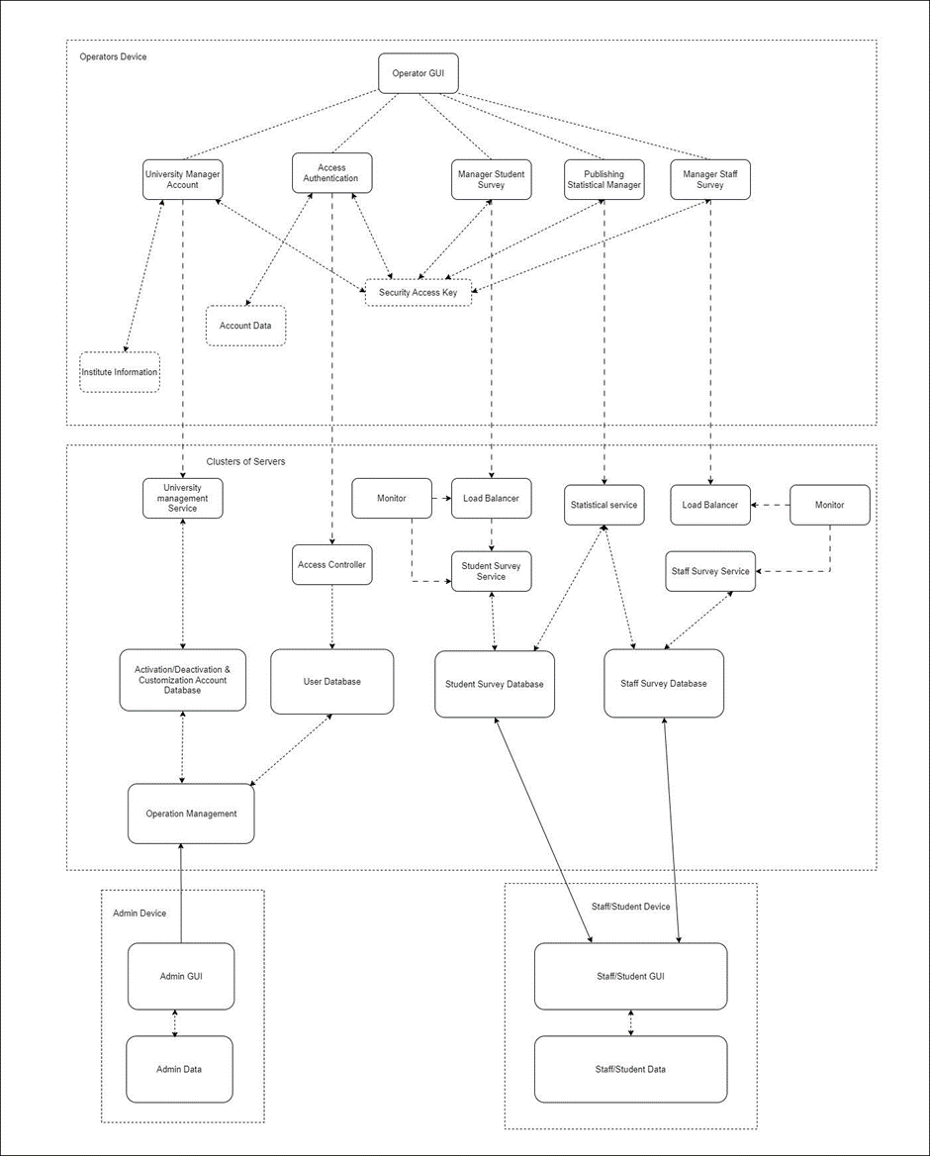
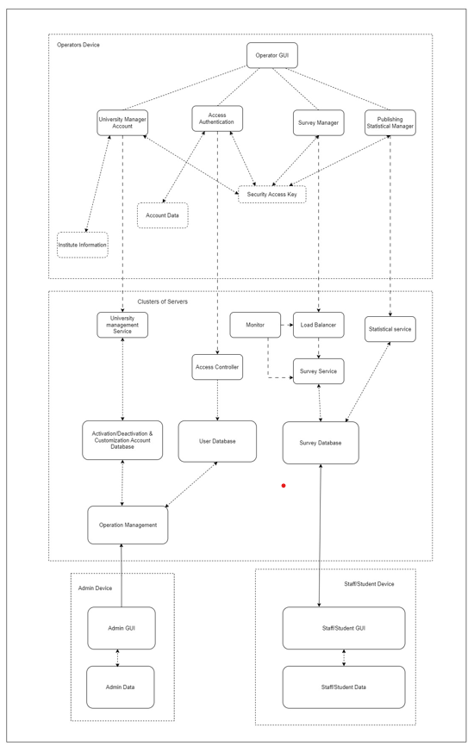
Initial design
Updated design

Slide 4
List of all API’s
Login
Create University Account
Get University Name
Activate User
Deactivate User
Customize User Account
Create Survey
Get Survey Results
Submit Survey Response
Publish Survey Results
Perform Statistical Analysis

Slide 5
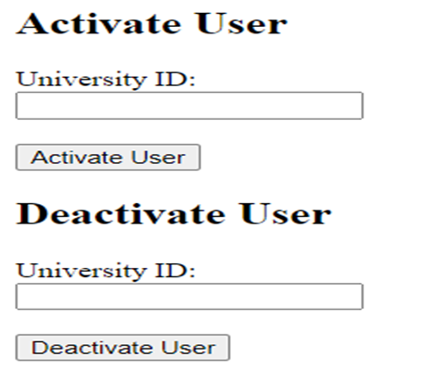
GUI Designs and API Connection
Activate/Deactivate the University Account GUI:
Design: This GUI enables an administrator to activate or deactivate a university account by entering the university ID and pressing the "Activate/Deactivate" button.
API Connection: When the "Activate/Deactivate" button is pressed, it sends a request to the /activate/{university_id} OR /deactivate/(university_id) API endpoint using the supplied university ID. The API processes the request and activates or deactivates the appropriate account.

Slide 6
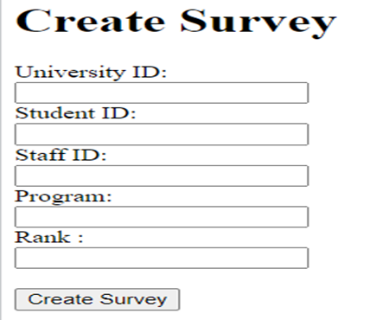
GUI Designs and API Connection
Create Survey GUI:
Design: This GUI provides a form for creating a new survey, including fields for survey details such as university ID, Student ID/Staff ID which is specified as per needs, Program and Rank.
API Connection: When the user submits the survey form, the GUI sends a request to the /survey/create/ API endpoint with the survey details. The API then creates the survey based on the provided information.

Slide 7
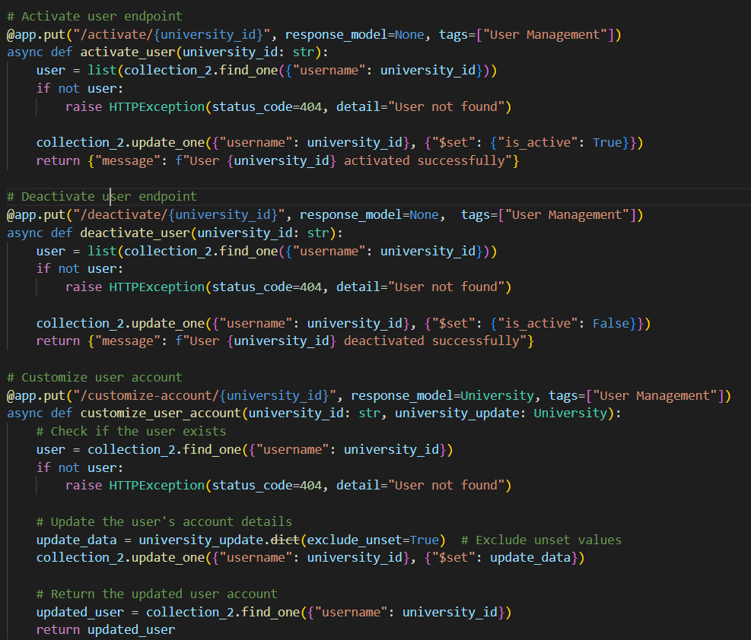
Implementation
The code is about university account management.
Services - Activate, Deactivate and Customize.
Language used is Python and MongoDB for database.
The Framework used here is FastAPI.
Virtual machine images and containers were created using Docker, and they were subsequently deployed on the Kubernetes cluster of the Google Cloud Platform.

Slide 8
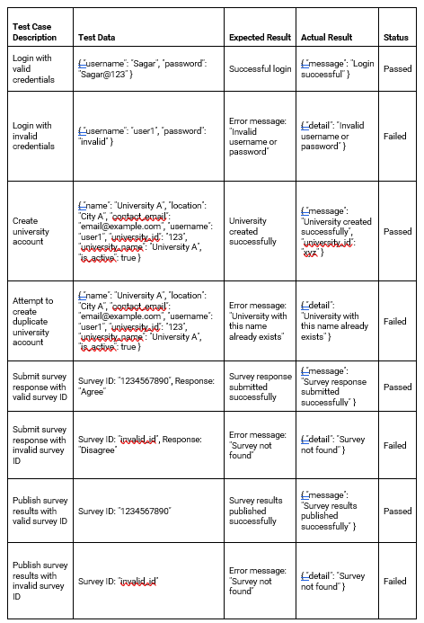
Test Cases

Slide 9
Demonstration
Link - http://34.134.129.213/docs#

Slide 10
Thank you.

